Slide 1
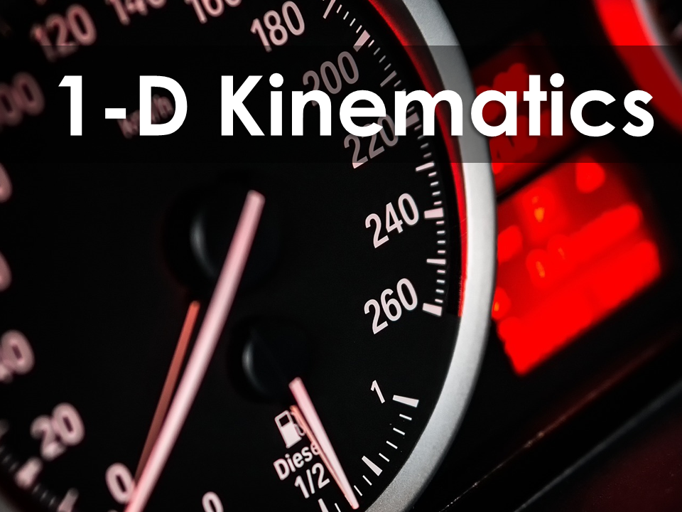
Kinematics
Preconceptions

Slide 2
Kinematics
Kinematics Preconceptions
How can you determine the speed of an object with only a tape measure and a stopwatch?
What does it mean to “accelerate”?
Does a car’s odometer and speedometer give an accurate measure of the car’s velocity?
What is a vector? Where have you heard this term before?

Slide 3
Kinematics
Kinematics Preconceptions
What would hit the ground first if dropped together from the same height: a baseball or a heavier bowling ball?
Create a list of reasons for which you would want to know the speed of an object.
What are you excited to learn about in this unit?

Slide 4
Any questions?

