Slide 1
Speed &
Velocity

Slide 2

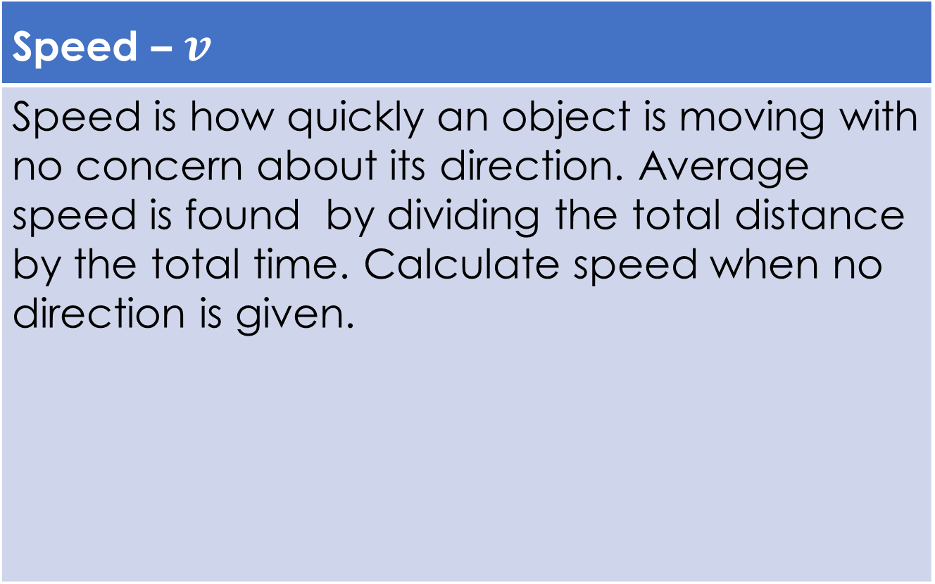



Speed and Velocity
Speed – $v$
Speed is how quickly an object is moving with no concern about its direction. Average speed is found by dividing the total distance by the total time. Calculate speed when no direction is given.
$m$ or $km$
$$v_{av}=\frac{d}{Δt}$$
$\frac{m}{s}$ or $\frac{km}{h}$
$s$ or $h$

Slide 3

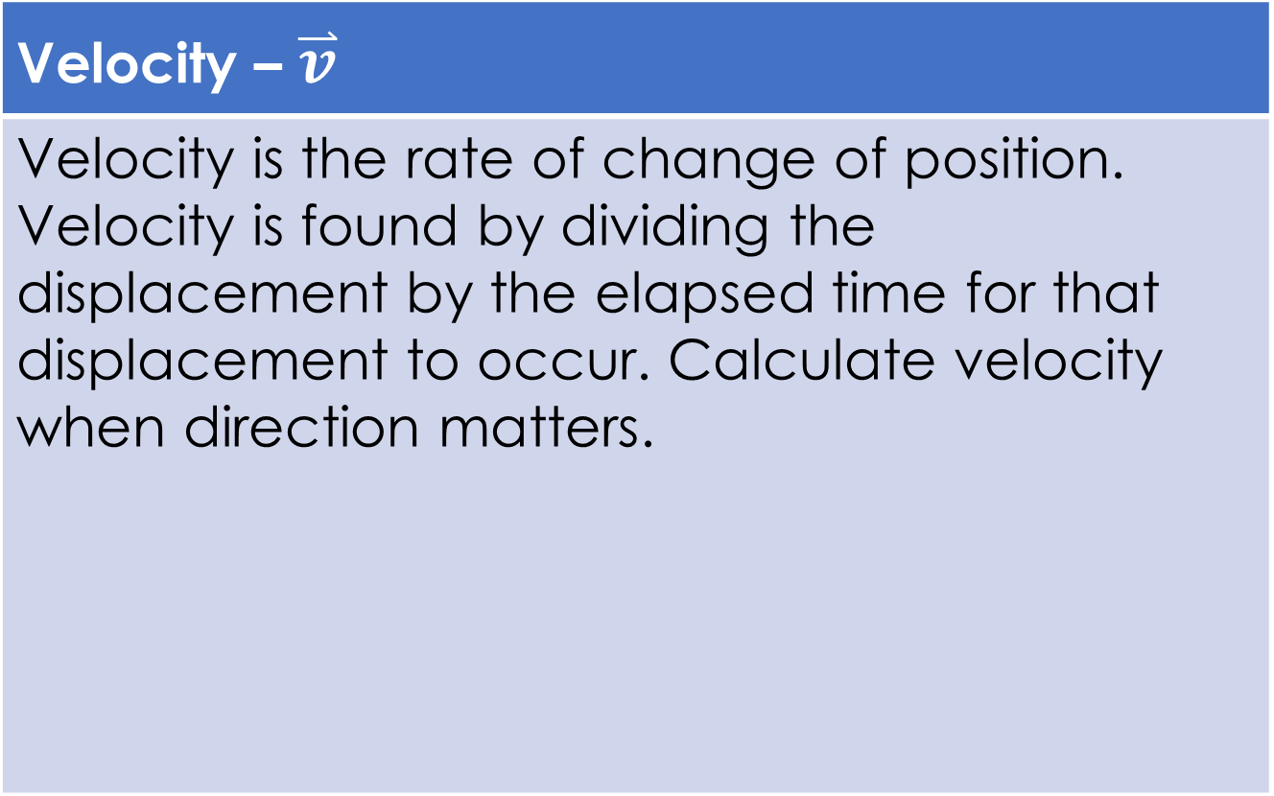
Speed and Velocity
Velocity – $\overset{⃑}{v}$
Velocity is the rate of change of position. Velocity is found by dividing the displacement by the elapsed time for that displacement to occur. Calculate velocity when direction matters.
Vectors
$m$ or $km$
$${\overset{⃑}{v}}_{av}=\frac{Δ\overset{⃑}{d}}{Δt}$$
$\frac{m}{s}$ or $\frac{km}{h}$
$s$ or $h$

Slide 4
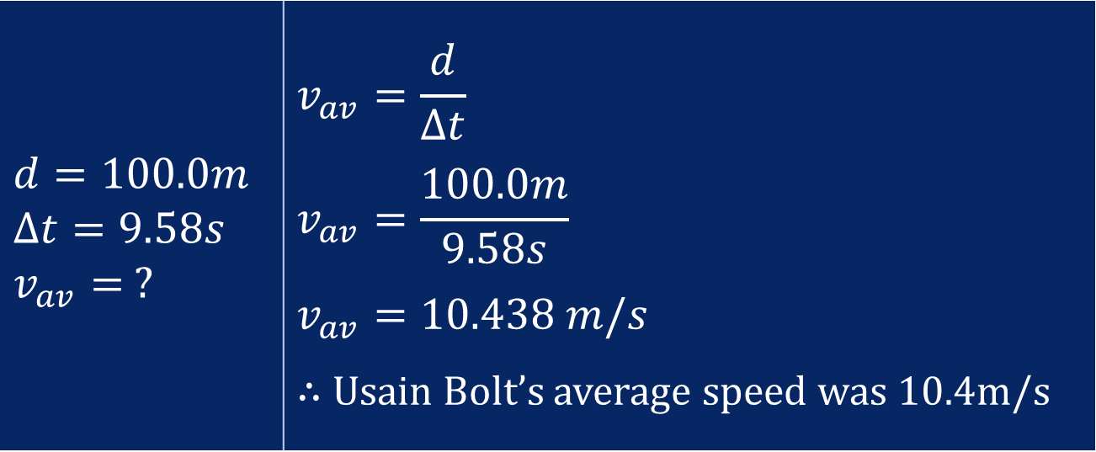
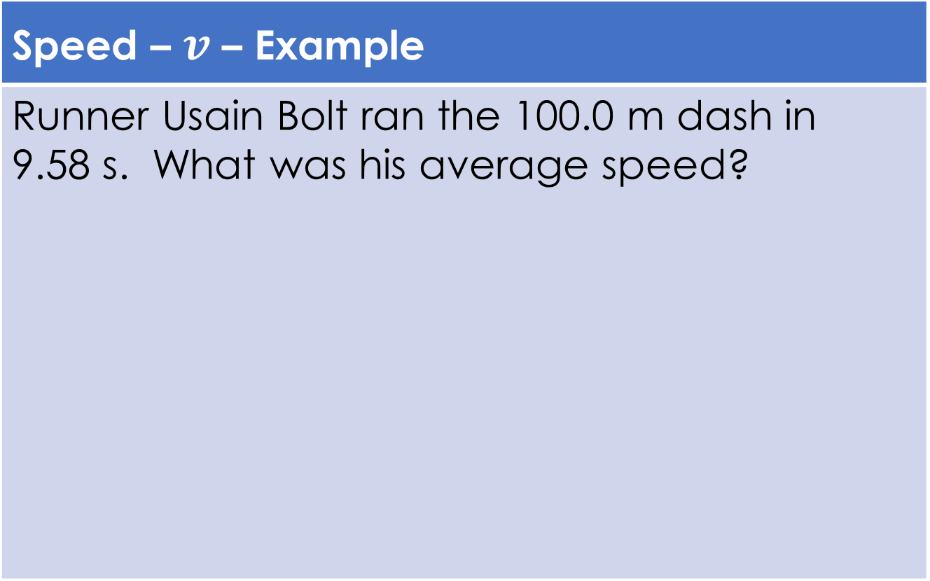
Speed and Velocity
Speed – $v$ – Example
Runner Usain Bolt ran the 100.0 m dash in 9.58 s. What was his average speed?
$$d=100.0m$$ $$Δt=9.58s$$ $$v_{av}= ?$$ | $$v_{av}=\frac{d}{Δt}$$ $$v_{av}=\frac{100.0m}{9.58s}$$ $$v_{av}=10.438 m/s$$ $∴$ Usain Bolt’s average speed was 10.4m/s

Slide 5
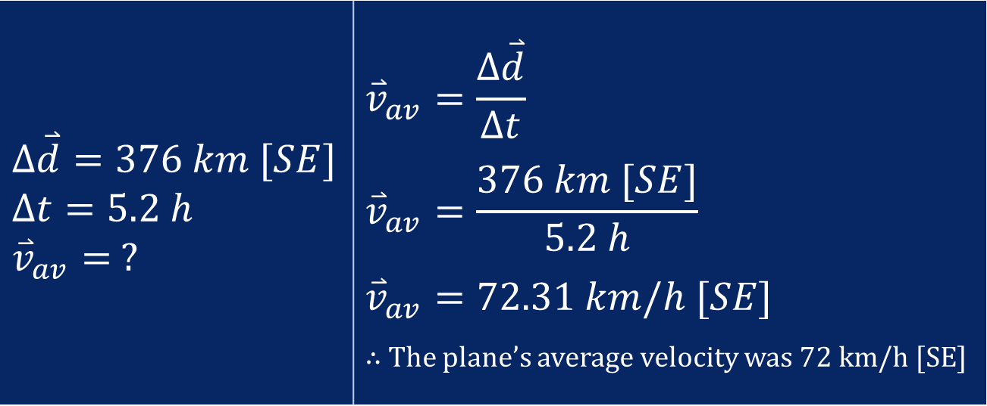
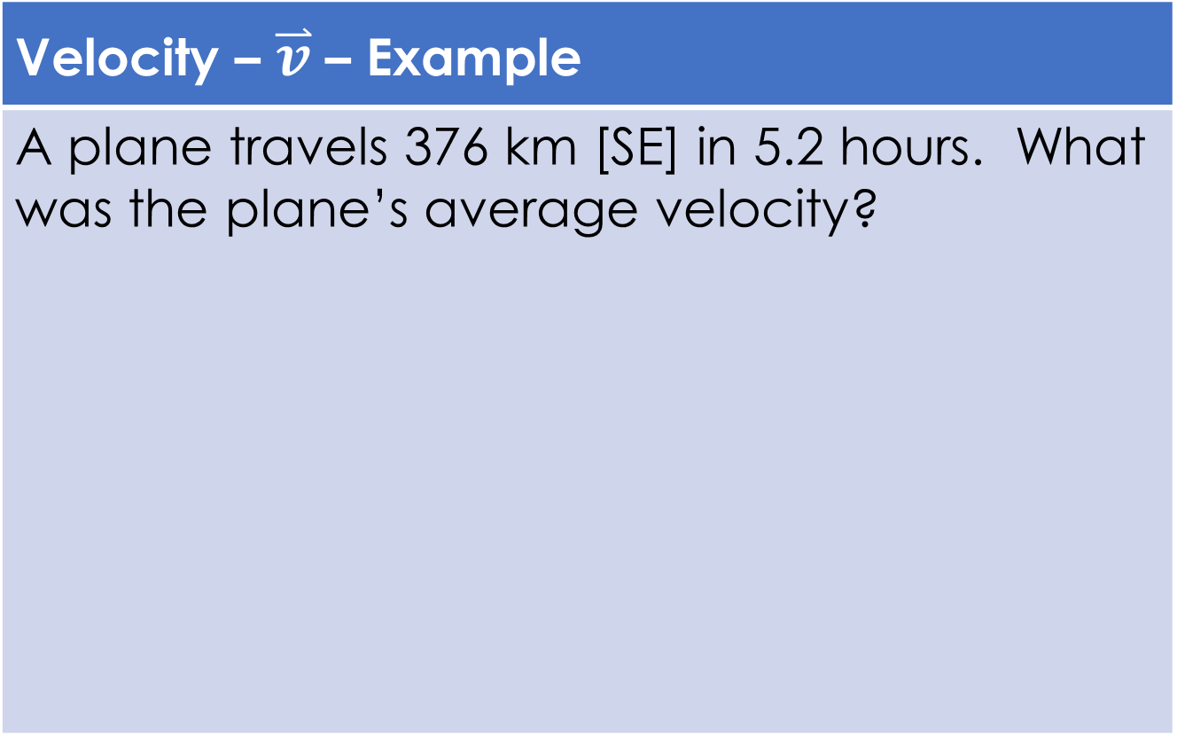
Speed and Velocity
Velocity – $\overset{⃑}{v}$ – Example
A plane travels 376 km [SE] in 5.2 hours. What was the plane’s average velocity?
$$Δ\overset{⃑}{d}=376 km [SE]$$ $$Δt=5.2 h$$ $${\overset{⃑}{v}}_{av}= ?$$ | $${\overset{⃑}{v}}_{av}=\frac{Δ\overset{⃑}{d}}{Δt}$$ $${\overset{⃑}{v}}_{av}=\frac{376 km [SE]}{5.2 h}$$ $${\overset{⃑}{v}}_{av}=72.31 km/h [SE]$$ $∴$ The plane’s average velocity was 72 km/h [SE]

Slide 6
Any questions?

