Slide 1
Position-Time
Graphs

Slide 2
Position-Time Graphs
In math classes you have examined graphs and determined information about different patterns. You have also taken patterns and graphed them.
We will do the same here to help us analyze motion in the Kinematics unit. This is a very powerful tool – the equations for this unit are derived from graphs.

Slide 3
Position-Time Graphs
The easiest graph to analyze is the position-time graph. For all position-time graphs, time is the independent variable (along the horizontal axis) and position is the dependent variable (along the vertical axis).
For a position-time graph there are only two skills needed to properly analyze the graph:
Reading values off the graph.
Finding the slope of the graph.

Slide 4
Position-Time Graphs
The easiest graph to analyze is the position-time graph. For all position-time graphs, time is the independent variable (along the horizontal axis) and position is the dependent variable (along the vertical axis).
For a position-time graph there are only two skills needed to properly analyze the graph:
Reading values off the graph.
Finding the slope of the graph.

Slide 5
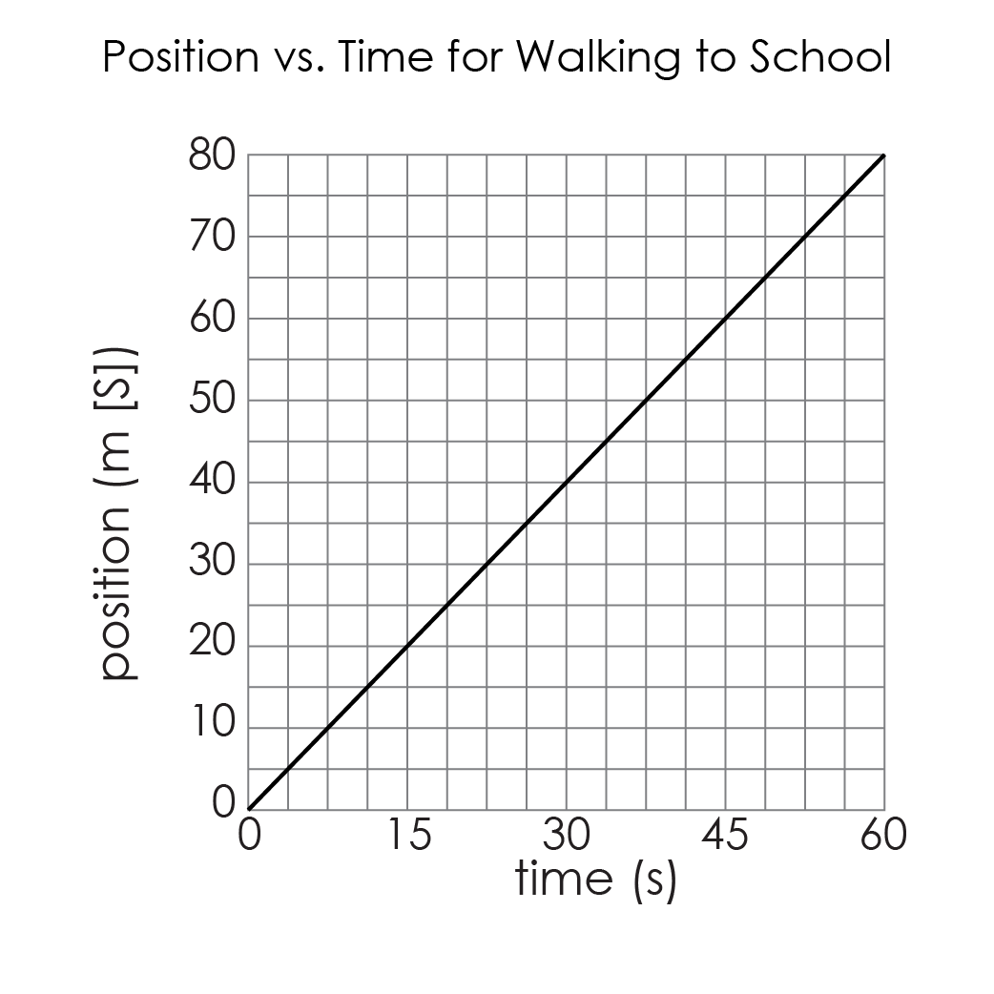
Position-Time Graphs
Consider the simple graph, Position vs. Time for Walking to School.
Examine the graph to answer the questions that follow.

Slide 6
Position-Time Graphs
Where does the student start walking from?
Home / $\overset{⃑}{d}=0m$
Where is the student walking to?
School / $\overset{⃑}{d}=80m [S]$
How far is the student’s home from school?
$$80m [S]$$

Slide 7
Position-Time Graphs
Where does the student start walking from?
Home / $\overset{⃑}{d}=0m$
Where is the student walking to?
School / $\overset{⃑}{d}=80m [S]$
How far is the student’s home from school?
$$80m [S]$$

Slide 8
Position-Time Graphs
Where does the student start walking from?
Home / $\overset{⃑}{d}=0m$
Where is the student walking to?
School / $\overset{⃑}{d}=80m [S]$
How far is the student’s home from school?
$$80m [S]$$

Slide 9
Position-Time Graphs
Where does the student start walking from?
Home / $\overset{⃑}{d}=0m$
Where is the student walking to?
School / $\overset{⃑}{d}=80m [S]$
How far is the student’s home from school?
$$80m [S]$$

Slide 10
Position-Time Graphs
How long does it take for the student to walk to school? $60s$
How far has the student walked after 30 seconds? $40m [S]$
How long did it take the student to walk 20 m?
$$\sim 27s$$

Slide 11
Position-Time Graphs
How long does it take for the student to walk to school? $60s$
How far has the student walked after 30 seconds? $40m [S]$
How long did it take the student to walk 20 m?
$$\sim 27s$$

Slide 12
Position-Time Graphs
How long does it take for the student to walk to school? $60s$
How far has the student walked after 30 seconds? $40m [S]$
How long did it take the student to walk 20 m?
$$\sim 27s$$

Slide 13
Position-Time Graphs
How long does it take for the student to walk to school? $60s$
How far has the student walked after 30 seconds? $40m [S]$
How long did it take the student to walk 20 m?
$$\sim 15s$$

Slide 14
Position-Time Graphs
All the previous information can be read from the graph.
Reading information from a position time graph provides information about the position.

Slide 15
Position-Time Graphs
Find the slope of the graph.
$m=\frac{rise}{run}$ $m=\frac{80m}{60s}[S]$ $m=\frac{1.\overline{3}m}{s} [S]$

Slide 16
Position-Time Graphs
Examine the units of the slope.
Considering the units, what information does the slope of a position-time graph provide?

Slide 17
Position-Time Graphs
The units of the slope are $\frac{m}{s}$, with a direction. The slope’s unit match with the units for velocity.
The slope of a position-time graph gives velocity.

Slide 18
Position-Time Graphs
Average Velocity Equation
Similar to math class: $m=\frac{y_{2}−y_{1}}{x_{2}−x_{1}}$
Slope: | $$m=\frac{rise}{run}$$ $$m=\frac{{\overset{⃑}{d}}_{2}−{\overset{⃑}{d}}_{1}}{t_{2}−t_{1}}$$ $$m=\frac{Δ\overset{⃑}{d}}{Δt}$$ $${\overset{⃑}{v}}_{av}=\frac{Δ\overset{⃑}{d}}{Δt}$$
$∗$ Use whichever variation of this equation that best suits the situation.
Change in position
Change in time
Displacement
Slope is the velocity

Slide 19
Position-Time Graphs
Through comparing graphs on the same scale, we can learn more about what the shape of a graph tells us.
Three siblings walk to the same school 300 meters east from the same home.
Rank which sibling you think is the fastest and the slowest. Then calculate the slope to determine their average velocities.

Slide 20
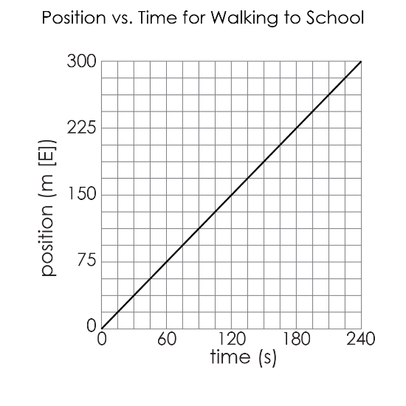
Acceleration
Alfie
 | $${\overset{⃑}{v}}_{av}=\frac{Δ\overset{⃑}{d}}{Δt}$$ $${\overset{⃑}{v}}_{av}=\frac{300m [E]}{240s}$$ $${\overset{⃑}{v}}_{av}=\frac{1.25m}{s}[E]$$

Slide 21
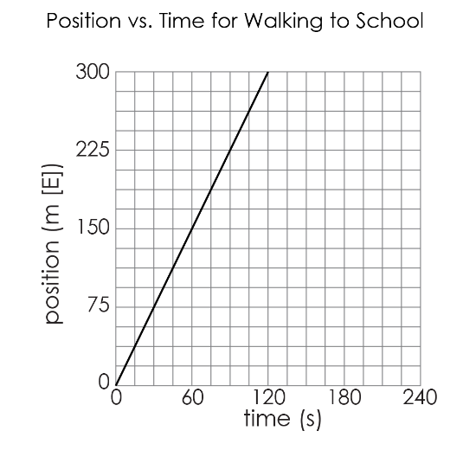
Acceleration
Beth
 | $${\overset{⃑}{v}}_{av}=\frac{Δ\overset{⃑}{d}}{Δt}$$ $${\overset{⃑}{v}}_{av}=\frac{300m [E]}{120s}$$ $${\overset{⃑}{v}}_{av}=\frac{2.5m}{s}[E]$$

Slide 22
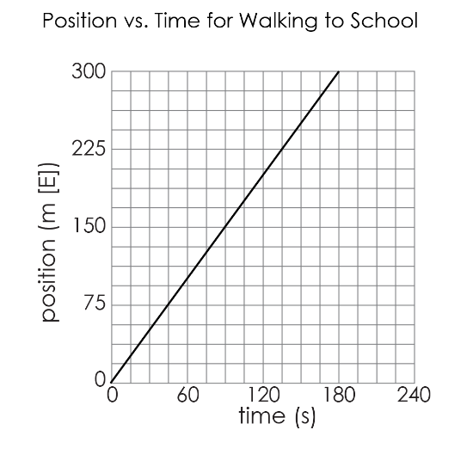
Acceleration
Cameron
 | $${\overset{⃑}{v}}_{av}=\frac{Δ\overset{⃑}{d}}{Δt}$$ $${\overset{⃑}{v}}_{av}=\frac{300m [E]}{180s}$$ $${\overset{⃑}{v}}_{av}=\frac{1.6m}{s}[E]$$

Slide 23
Position-Time Graphs
Summarize how the slope of the line on a position-time graph relates to an object’s velocity:
A steeper slope indicates a faster velocity.

Slide 24
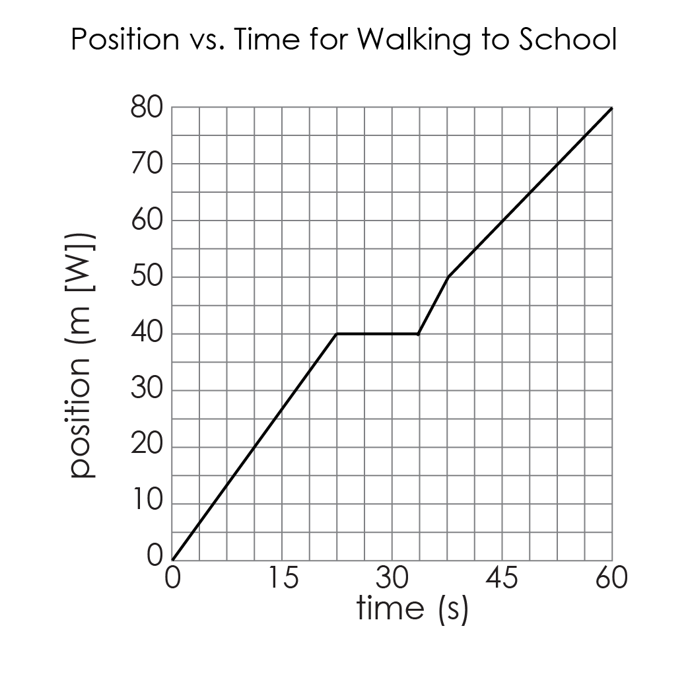
Position-Time Graphs
Position-time graphs can be made of multiple lines with different slopes.
Describe this student’s motion.

Slide 25
Position-Time Graphs
Student walks at a steady pace
Student stops
Student moves quicker for a short time
Student walks at a steady pace

Slide 26
Position-Time Graphs
During what time interval is the student moving the fastest?

Slide 27
Position-Time Graphs
During what time interval is the student moving the fastest?
Between
$$t=33.75s \& 37.5s$$

Slide 28
Position-Time Graphs
Determine the student’s average velocity in that time interval.
$${\overset{⃑}{v}}_{av}=\frac{{\overset{⃑}{d}}_{2}−{\overset{⃑}{d}}_{1}}{t_{2}−t_{1}}$$ $${\overset{⃑}{v}}_{av}=\frac{50m\left[W\right]−40m[W]}{37.5s−33.75s}$$ $${\overset{⃑}{v}}_{av}=\frac{10m[W]}{3.75s}$$ ${\overset{⃑}{v}}_{av}=2.\overline{6}$m/s[W]

Slide 29
Position-Time Graphs
What is the meaning of the horizontal line?
Prove it by determining the slope in that section.

Slide 30
Position-Time Graphs
The horizontal line means the person was stopped (position did not change)
$${\overset{⃑}{v}}_{av}=\frac{{\overset{⃑}{d}}_{2}−{\overset{⃑}{d}}_{1}}{t_{2}−t_{1}}$$ $${\overset{⃑}{v}}_{av}=\frac{40m\left[W\right]−40m[W]}{33.75s−22.5s}$$ ${\overset{⃑}{v}}_{av}=$ 0m/s

Slide 31
Position-Time Graphs
How does this student’s average velocity for the entire walk to school compare with the first student’s average velocity?

Slide 32
Position-Time Graphs
Both students walked the same distance in 60s. Magnitudes are the same, even though second student changed velocity throughout.
Directions are different (W vs. S)
$${\overset{⃑}{v}}_{av}=\frac{Δ\overset{⃑}{d}}{Δt}$$ $${\overset{⃑}{v}}_{av}=\frac{80m [W]}{60s}$$ $${\overset{⃑}{v}}_{av}=\frac{1.\overline{3}m}{s}[W]$$

Slide 33
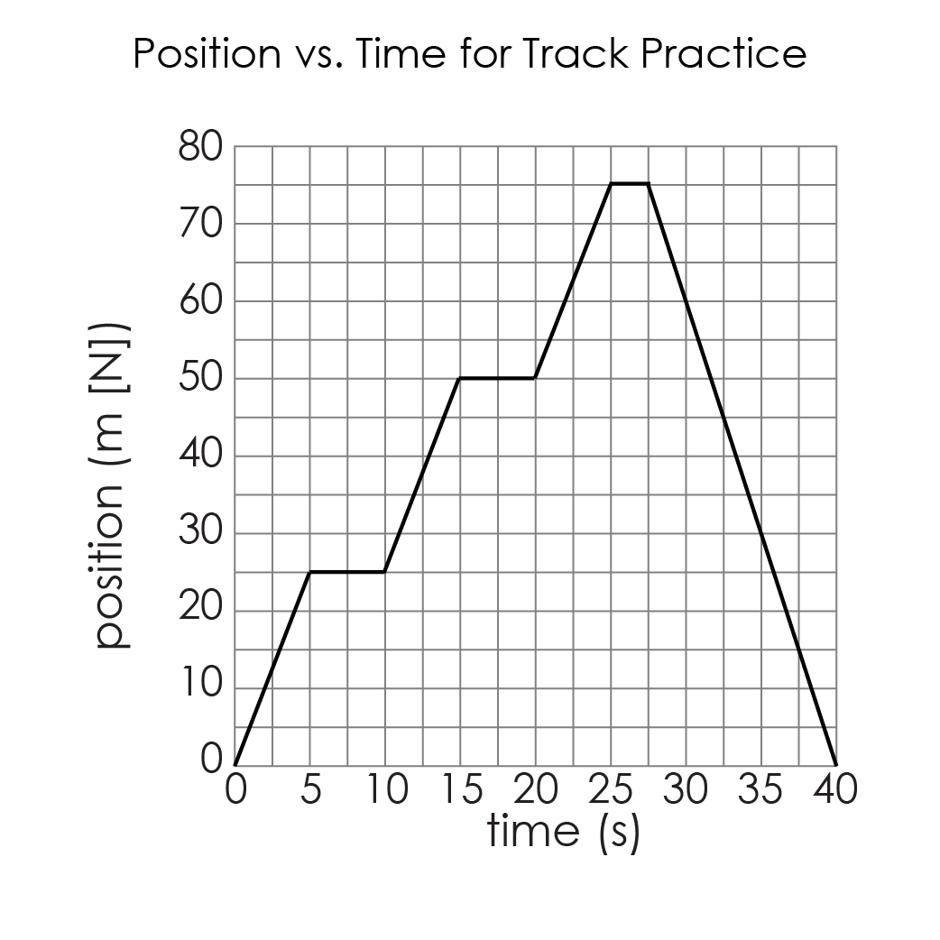
Position-Time Graphs
Examine the position-time graph for track practice.
Describe the motion of the runner.

Slide 34
Position-Time Graphs
The runner is running, stops, running, stops, running slightly slower, stops, changes direction and runs back to the starting position.

Slide 35
Position-Time Graphs
What is the runner doing in the sections with horizontal lines?

Slide 36
Position-Time Graphs
What is the runner doing in the sections with horizontal lines?
The runner is stopped during the sections with the horizontal lines because
$\overset{⃑}{v}=slope=0m/s$

Slide 37
Position-Time Graphs
Find the average velocity of the runner in the last section. What does the sign mean?

Slide 38
Position-Time Graphs
$${\overset{⃑}{v}}_{av}=\frac{{\overset{⃑}{d}}_{2}−{\overset{⃑}{d}}_{1}}{t_{2}−t_{1}}$$ $${\overset{⃑}{v}}_{av}=\frac{0m\left[N\right]−75m[N]}{40s−27.5s}$$ ${\overset{⃑}{v}}_{av}=$ -6m/s [N] $∴$ the runner’s average velocity in the last section is -6m/s[N]. The negative sign indicates direction: it is negative, so the opposite of North. The runner’s velocity is 6m/s [S].

Slide 39
Position-Time Graphs
What is the runner’s final position and overall displacement?
The runner’s final position is $\overset{⃑}{d}=0m$ and overall displacement is $Δ\overset{⃑}{d}=0m$.

Slide 40
Position-Time Graphs Summary
Key Terms | Equations
Position-time graph Shows the position of an object as a function of time Reference point The horizontal axis of a $\overset{⃑}{d}−t$ graph Slope Slope of the graph gives velocity | Slope gives velocity $$m={\overset{⃑}{v}}_{av}$$ $${\overset{⃑}{v}}_{av}=\frac{{\overset{⃑}{d}}_{2}−{\overset{⃑}{d}}_{1}}{t_{2}−t_{1}}$$ $${\overset{⃑}{v}}_{av}=\frac{Δ\overset{⃑}{d}}{Δt}$$

Slide 41
Position-Time Graphs Summary
Describe, with the aid of diagrams, how the slope of a position-time graph relates to the object’s average velocity. Include horizontal lines and lines with negative slope.

Slide 42
Position-Time Graphs Summary
Horizontal Line
 | Means object is stopped $slope=0, velocity=0$ Position does not change over time
$$\overset{⃑}{d}$$
$$t$$

Slide 43
Position-Time Graphs Summary
Line with Positive Slope
 | Moving with constant velocity in the positive direction $slope>0⇒\overset{⃑}{v}>0$ $∗$ The larger the slope (the steeper the line) the FASTER the object is moving.
$$\overset{⃑}{d}$$
$$t$$
Starts at reference point

Slide 44
Position-Time Graphs Summary
Line with Negative Slope
 | Moving with constant velocity in the NEGATIVE direction $slope<0⇒\overset{⃑}{v}<0$ $∗$ Steeper graphs (larger magnitudes for slope) indicate the object is moving FASTER.
$$\overset{⃑}{d}$$
$$t$$
Starts somewhere other than reference point

Slide 45
Any questions?

